Slide 1
Operations Security (OPSEC): A Force Multiplier
Mr. Cleve Page
USSOCOM OPSEC Support Element

Slide 2
Overview
A Force Multiplier?
Essential Secrecy
What is OPSEC?
The 5 Step Process
Let’s Wrap This Up

Slide 3
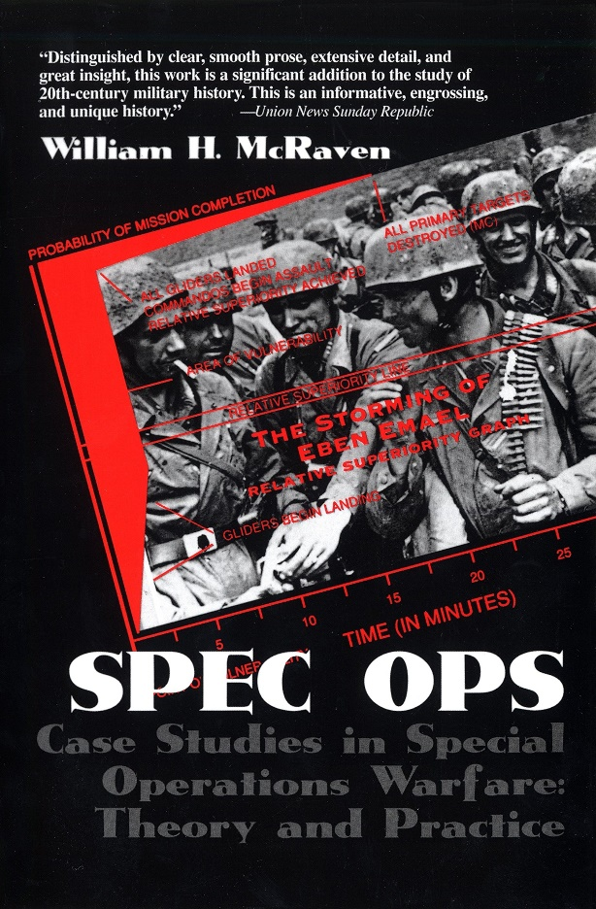
A Force Multiplier?
Special Operations
Small teams doing incredible things
Punching above their weight
How Do We Do This?
Multiple pieces to the equation
Must achieve essential secrecy

Slide 4
Essential Secrecy
The condition achieved from the denial of critical information to adversaries.
Defense Dictionary of Military and Associated Terms; JP 1-02

Slide 5
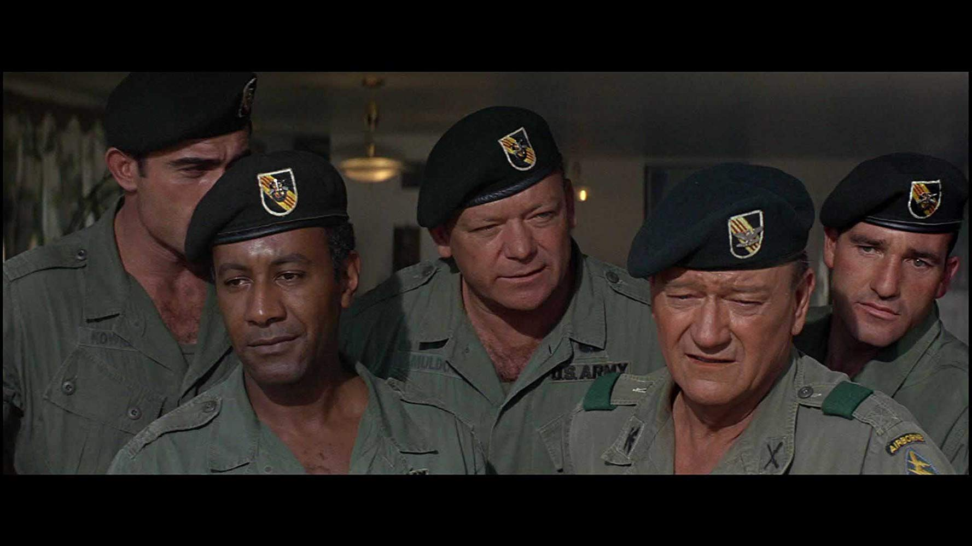

Slide 7
What is OPSEC?
Risk Analysis Process
Vietnam
NSDD 298 (22 Jan 1988)
Identifies what to protect, when, and how
Adversary & Friendly Perspectives
Value of unclassified information
Is based on its importance to both adversary and friendly objectives, and establishes subsequent impact to the organization or mission if that information is lost.

Slide 8
The OPSEC Model
Analyze Threat
Identify Critical Information
Apply OPSEC Measures
Analyze Vulnerabilities
Determine Risk

Slide 9
The OPSEC Model
Analyze Threat
Identify Critical Information
Apply OPSEC Measures
Analyze Vulnerabilities
Determine Risk

Slide 10
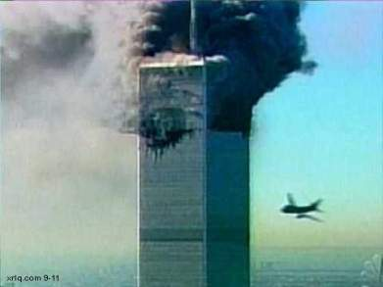
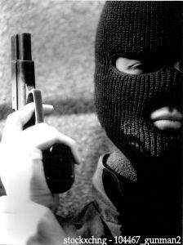
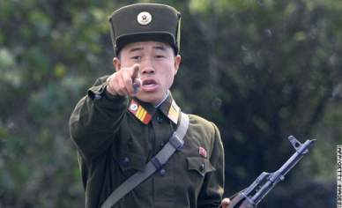
Who’s the Threat?

Slide 11
Elements of Threat
Intent
History
Doctrine
Capability to Gather Information
Intelligence Disciplines
Friends of the Adversary

Slide 12
The Intelligence Process
Planning, Requirements and Direction
Collection
Analysis and Processing
Production
Dissemination

Slide 13
The Intelligence Process
Planning, Requirements and Direction
Collection
Analysis and Processing
Production
Dissemination

Slide 14
Intelligence Disciplines
HUMINT – Human Intelligence
GEOINT – Geospatial Intelligence
MASINT – Measurement and Signal Intelligence
OSINT – Open Source Intelligence
SIGINT – Signals Intelligence
TECHINT – Technical Intelligence
CYBINT/DNINT – Cyber/Digital Network Intel
FNINT – Financial Intelligence
Source: https://en.wikipedia.org/wiki/List_of_intelligence_gathering_disciplines

Slide 15
The OPSEC Model
Analyze Threat
Identify Critical Information
Apply OPSEC Measures
Analyze Vulnerabilities
Determine Risk

Slide 16
Identify Critical Information
Two Perspectives
Friendly
Adversary
Make a List (CIL)
Make sure your people know what’s on the list

Slide 17
The OPSEC Model
Analyze Threat
Identify Critical Information
Apply OPSEC Measures
Analyze Vulnerabilities
Determine Risk

Slide 18
Analyze Vulnerabilities
Where might an adversary gather information on you?
Consider all intelligence capabilities
Newsletters
Contract awards
Trade shows
Technical Inquiries

Slide 19
The OPSEC Model
Analyze Threat
Identify Critical Information
Apply OPSEC Measures
Analyze Vulnerabilities
Determine Risk

Slide 20
Determine Risk
So What?
How will the info help the adversary and hurt me?
How much will this cost?
What’s the risk tolerance?
Quantify
Decisions based on good analysis.

Slide 21
The OPSEC Model
Analyze Threat
Identify Critical Information
Apply OPSEC Measures
Analyze Vulnerabilities
Determine Risk

Slide 22
Apply OPSEC Measures
Implement Measures and see if it works
How?
Measures of Performance (MOP)
Measures of Effectiveness (MOE)
Run the OPSEC Process regularly or as mission / purpose / capabilities change

Slide 23
Let’s Wrap This Up
OPSEC is proven
OPSEC is adaptable
The need for OPSEC is not diminishing

Slide 24
Questions ?

